Slide 1
HARDWARE MATH
Instructor: john ortiz
Lecturer III utsa
stego@satx.rr.com
CS 3843 computer organization

Slide 2
Logical Operations Review
NOT
Invert all the bits
One’s complement
(N) AND
All inputs must be 1 for result to be one
Think multiplication: 1 * 1 * 1 * 1 * … if any one of the inputs is a zero, the result is zero
For NAND, same thing except result is inverted
If any one of the inputs is a zero, the result is a one

Slide 3
Logical Operations Review
(N) OR
If any input is a one, the result is a one
Think addition, but the result is either zero or not zero
In order for the final result to be zero, all inputs must be zero
For NOR, same thing except result is inverted
In order for the final result to be one, all inputs must be zero
(XOR / XNOR)
If both inputs are the same, the result is zero
Think even vs. odd – even number of ones, result is zero
XNOR is also called “equivalence” because if the inputs are the same , the result is a one

Slide 4
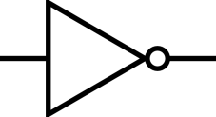



Logical Operations Review
Bitwise logical operations
Operates on each bit as specified below
NOT
! 0 = 1
! 1 = 0
AND OR
0 & 0 = 0 0 & 0 = 0
0 & 1 = 0 0 & 1 = 1
1 & 0 = 0 1 & 0 = 1
1 & 1 = 1 1 & 1 = 1
XOR
0 & 0 = 0
0 & 1 = 1
1 & 0 = 1
1 & 1 = 0

Slide 5
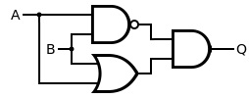
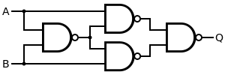
The XOR Gate
An XOR gate can be constructed from basic logical operations such as the two examples below
A | B | OUT
0 | 0 | 0
1 | 0 | 1
0 | 1 | 1
1 | 1 | 0

Slide 6
Hardware Logic
A brief look at the hardware that makes a computer work is based on the logical functions:
NOT
inverter
(N) AND
Enable / disable - (a one on one input enables the other)
Mask bits: AND a register with 0x0000000F and all bits except bottom 4 are zero – i.e. masked off
(N) OR
Enable / disable - (a zero on one input enables the other)
Mask bits: OR a register with 0x0000000F to ensure bottom 4 bits are one
Exclusive-OR (XOR) / Exclusive-NOR (XNOR)
Controllable inverter – (a one on one input inverts the other, a zero on one input does not)

Slide 7
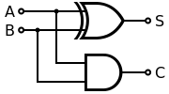
Logical – Half Adder
For binary arithmetic, XOR is an adder
0 + 0 = 0; 0 xor 0 = 0
0 + 1 = 1; 0 xor 1 = 1
1 + 0 = 1; 1 xor 0 = 1
1 + 1 = 2; 1 xor 1 = 0
Wait! 2 is not equal to zero!
But there is no “2” in binary, so it is expressed as 10 <one-zero>
Soooooo, the last digit is a ZERO as in the 1 xor 1
The 1 in the 2’s place is the carry out of adding 1 + 1
1 + 1 = zero, carry the one ➔ 10
Just like in decimal arithmetic: 1 + 9 = ten == 0 carry the 1 → 10
We can generate a carry in hardware by AND’ing the two inputs
Only when they are both one is the result a 1
1 and 1 = 1

Slide 8
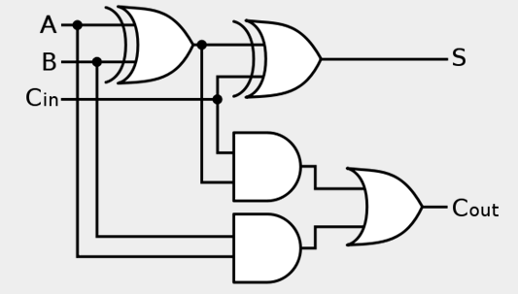
Hardware: Full Adder
The prior circuit was a one-bit half adder because it did not allow for a carry in
Adding a carry in and a little extra circuitry, we construct a one-bit full adder as shown below

Slide 9
Hardware: 4-Bit Full Adder
For multiple bits, cascade them together in parallel
Shown is a 4-bit full adder
But what about subtraction?
Of course we can build a subtractor
But better is to invert the sign of the
B input (i.e. neg B)
Taking two’s complement requires
inverting all the bits and adding one
XOR is a controllable inverter

Slide 10
Hardware: Addition & Subtraction
Initial carry in is the Add One
But what about subtraction?
Tie the first carry in to an
“Add/Sub” signal
If that is a ONE, all the bits
will be inverted and
we will add the negative

Slide 11
Summary of Skills
Logical Operations & Relevant Hardware
i.e. What IS on the test!!!

Slide 12
Questions & Comments

Slide 13
References
My brain

